Slide 1
Chapter 10 FIR Digital Filter Design
Preliminary Consideration
FIR Digital Filter Design Methods
MATLAB Functions in FIR Filter Design

Slide 2
10.1 Preliminary Consideration
Digital Filter Specifications
Basic Approach to FIR Digital Filter Design
FIR Digital Filter Order Estimation
（理解）

Slide 3

10.1.1 Basic Approaches to design FIR filters
Unlike IIR digital filter design, FIR filter design does not have any connection with the design of analog filters.
The design of FIR filters is based on a direct approximation of the specified magnitude response, with often added requirement that the phase response be linear.
（理解）

Slide 4
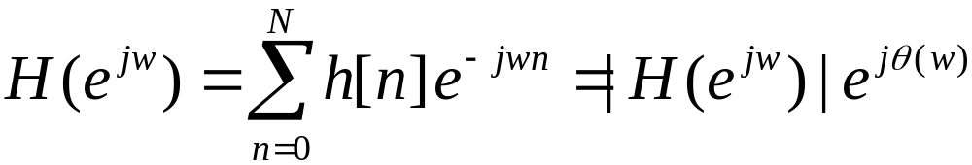
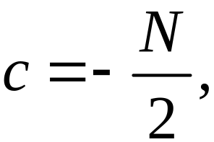

Recall a causal FIR frequency response H(e ^{jω}) of length N+1:
Magnitude Response
Phase Response
For a linear-phase FIR, we have:
Or, as we known: h[n] = ± h[N-n]
For β= 0, π, ±π/2
（理解）

Slide 5
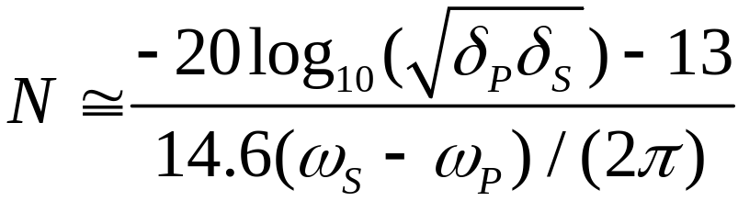
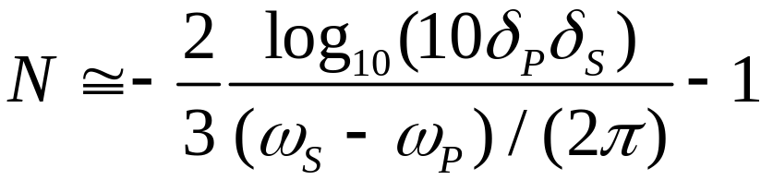
10.1.2 Estimation of the Filter Order
The order (length-1) of G(z) is directly estimated from the digital filter specification.
Several authors have advanced formulas :
Kaiser’s Formula:
Bellanger’s Formula:
（理解）

Slide 6
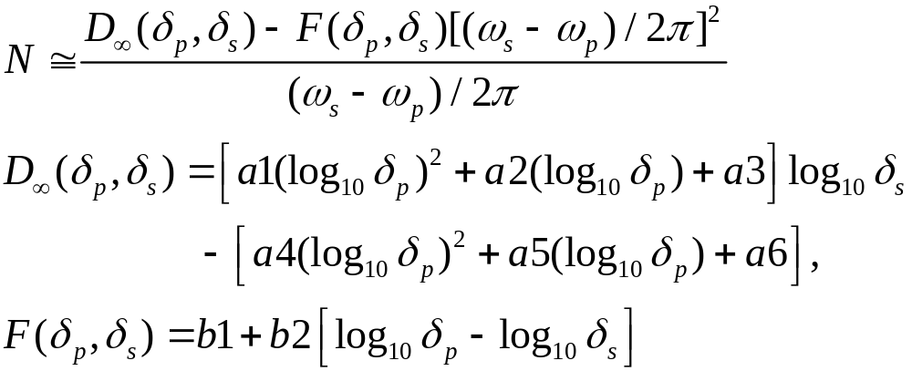
Estimation of the Filter Order
Hermann’s Formula:
a1=0.005309, a2=0.07114, a3=-0.4761, a4=0.00266, a5=0.5941, a6=0.4278, b1=11.01217, b2=0.51244
（理解）

Slide 7
A Comparison of FIR Filter Order Formulas:
(1) Each of these three formulas provide only an estimate of the required filter order.
(2) The estimated filter order N of the FIR filter is inversely proportional to the
transition band width (ω_{p}-ω_{s} ). And does not depend on the actual location of the transition band.
(3) The order of Kaiser’s and Bellanger’s formulas depends on the productδ_{p}and δ_{s}.
(4) Each one of three formulas can also be used to estimate the order of highpass, bandpass and bandstop FIR filter.
(5) For two transition bands, we always use the smallest width to compute the order of the filter.
（理解）

Slide 8
10.2 FIR Filter Design Based on Windowed Fourier Series
Two direct approaches to design of FIR filters:
(1) Truncating the Fourier series representation of the prescribed frequency response. (direct and straightforward)
(2) Sampling the frequency response to get the DFT of h[n], and
use IDFT to get h[n].
（掌握）

Slide 9
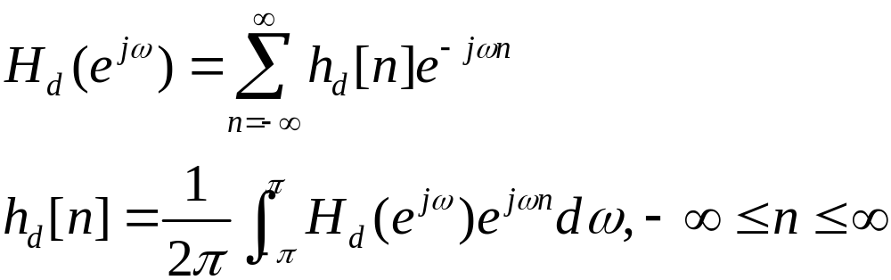
10.2.1 Least Integral-Squared Error Design of FIR Filters
Let H_{d}(e^{jω}) denote the desired frequency response function, h_{d}[n] denotes the impulse response samples, so :
Fourier series
In most applications, for meeting the FR H_{d}(e^{jω}) requirements, h_{d}[n] is infinite.
（掌握）

Slide 10
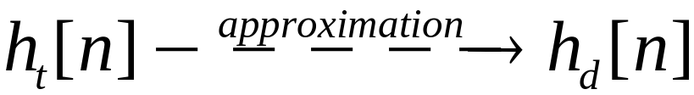
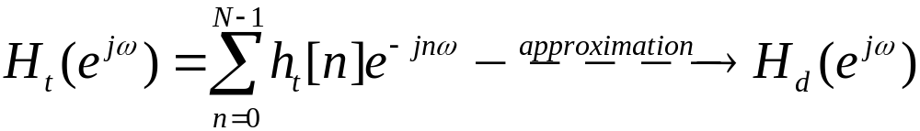
We want to find: a Length-N, causal
So:
The procedure of using h_{t}[n] to replace h_{d}[n] is called truncating or windowing.
Using what approximating criterion?
Minimum Integral-Squared Error.
（掌握）

Slide 11
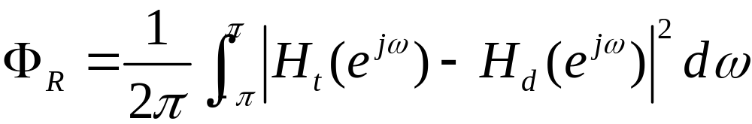
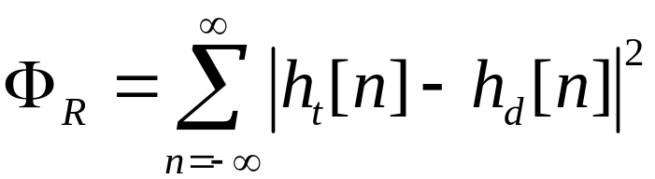
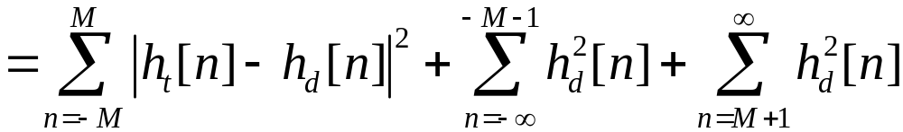

Define integral-squared error:
Using Parseval’s relation, we get:
When h_{t}[n]=h_{d}[n] for -M≤n≤M, the Φ_{R} is minimum.
Best finite-length approximation to ideal infinite-length impulse
response in the mean-square sense is obtained by truncation.
（掌握）

Slide 12
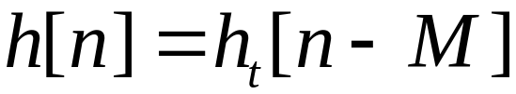
A causal FIR filter with an impulse response h[n] can be derived from h_{t}[n] by delaying:
The causal FIR filter h[n] has the same magnitude response as h_{t}[n] and its phase response has a linear phase shift of ωM radians with respect to that of h_{t}[n].
  h[n]---- linear phase
  h_{t}[n]----zero phase
（掌握）

Slide 13
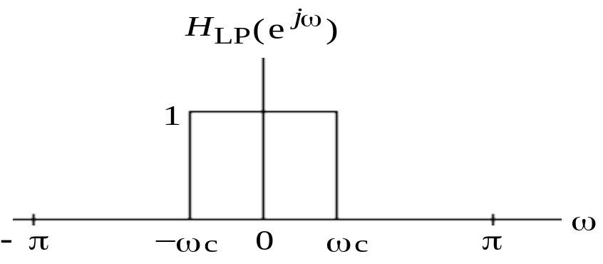
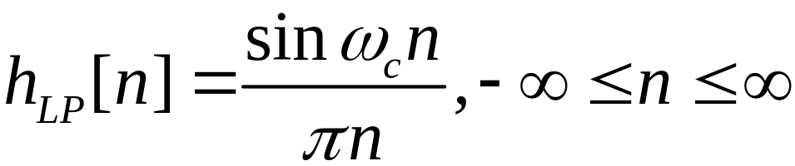
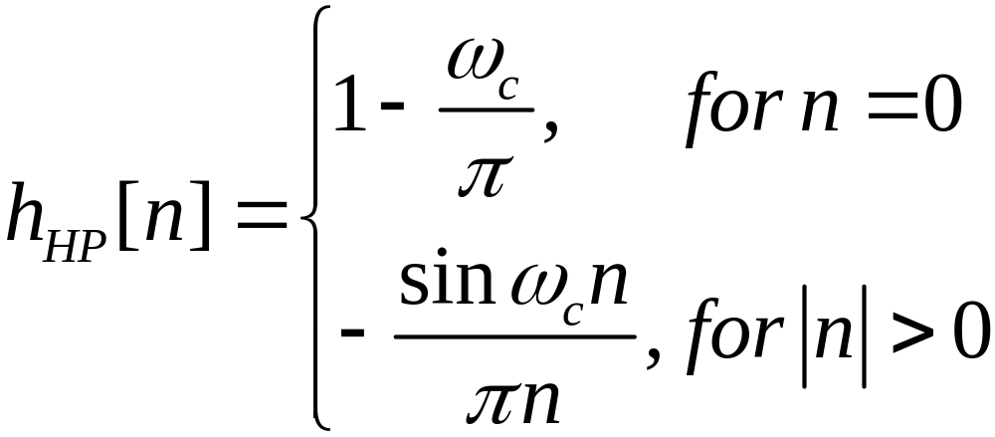
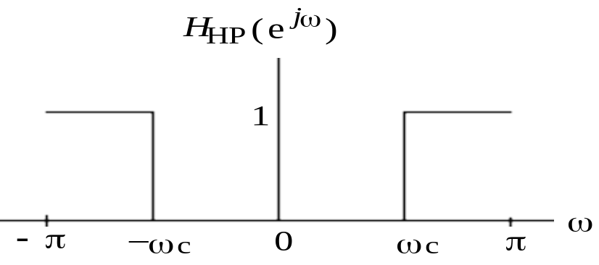
10.2.2 Impulse Responses of Ideal Filters
Ideal lowpass filter:
Ideal highpass filter:
（掌握）

Slide 14
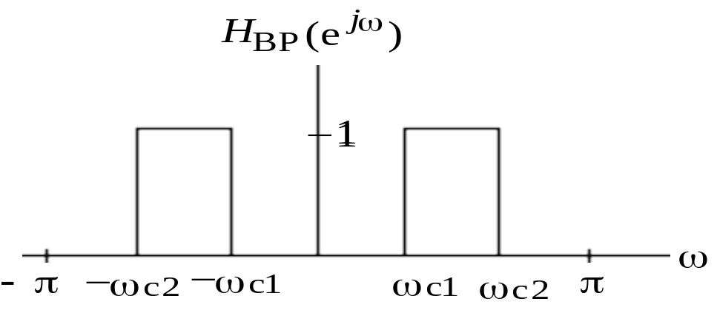
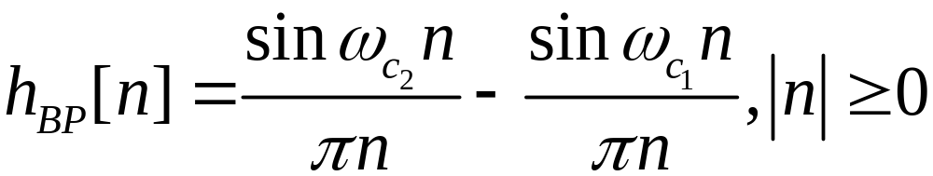
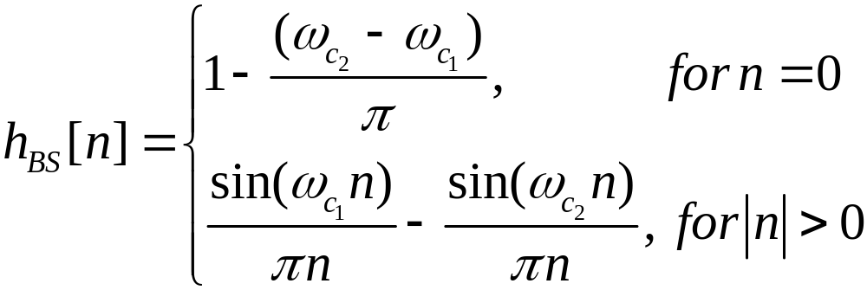
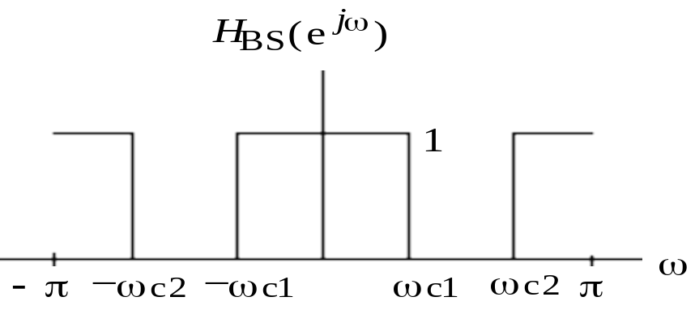
Ideal bandpass filter:
Ideal bandstop filter:
（掌握）

Slide 15
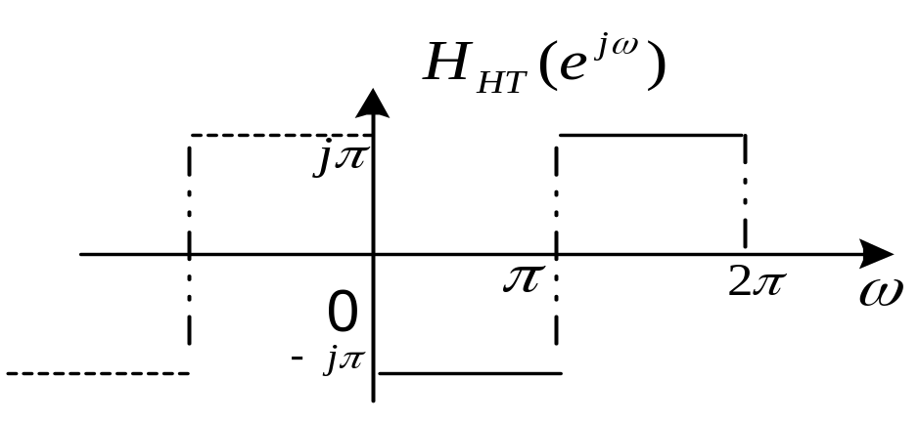
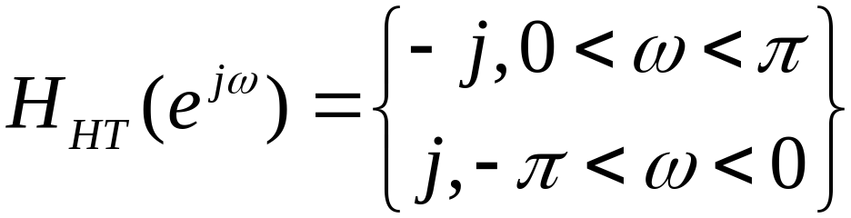
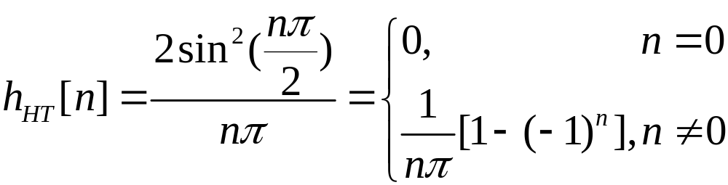
Hilbert transformer (90-degree phase shifter)
（掌握）

Slide 16
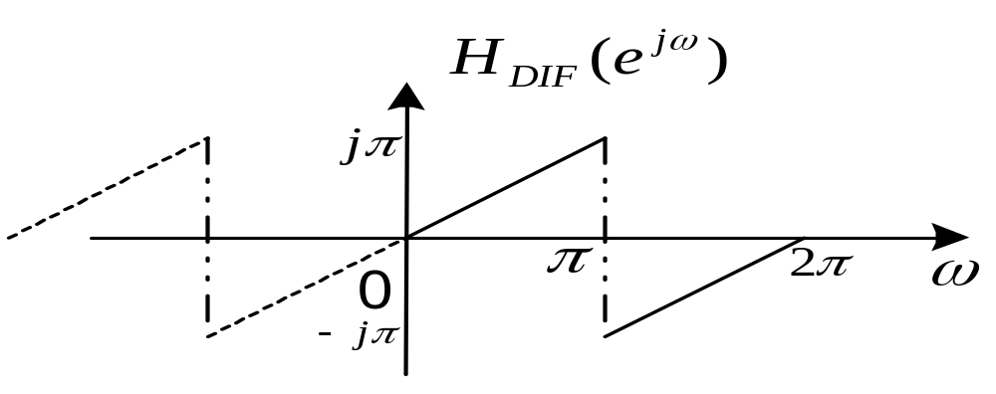

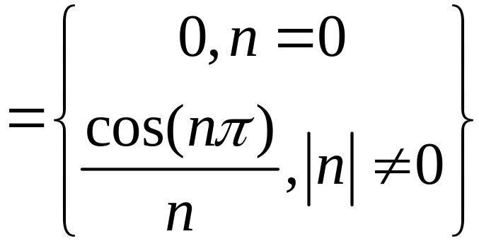
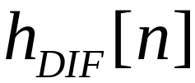
Differentiator:
（掌握）

Slide 17
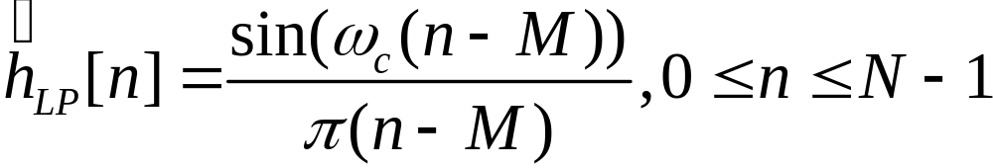
Truncate the h[n] of Ideal Lowpass Filter
The impulse response of ideal filter is infinite. By setting all coefficients outside the range -M≤ n ≤ M equal to zero, we arrive at a finite-length sequence.
And by shifting to the right yields the causal FIR lowpass filter which we need.
Note: In above expression, length N is 2M+1.
（掌握）

Slide 18
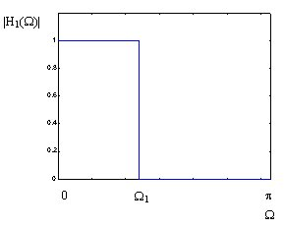
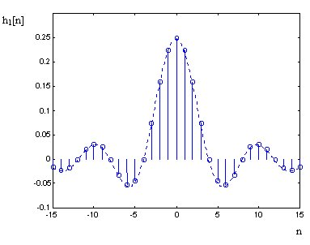
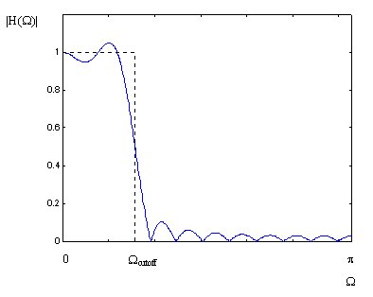
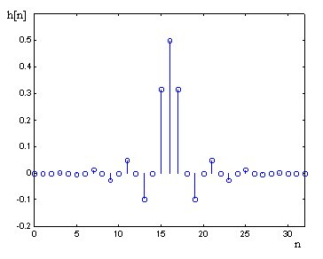
（掌握）

Slide 19
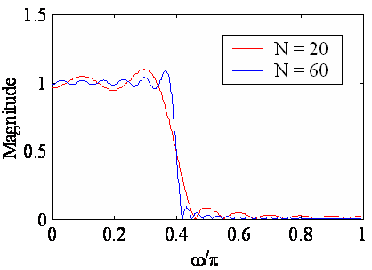
10.2.3 Gibbs Phenomenon -- The Effect of Truncating the h[n]
Gibbs phenomenon - Oscillatory behavior in the magnitude responses of causal FIR filters obtained by truncating the impulse response coefficients of ideal filter
（掌握）

Slide 20
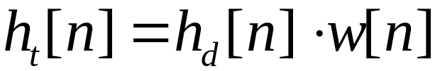
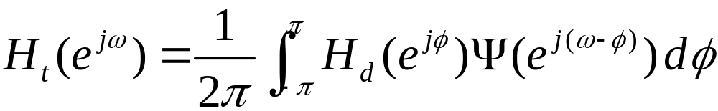
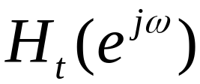
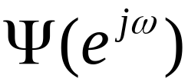
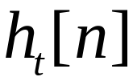

Gibbs Phenomenon Interpretation:
truncating operation → windowing operation:
In the frequency domain:
where and are the DTFTs of and , respectively.
（掌握）

Slide 21
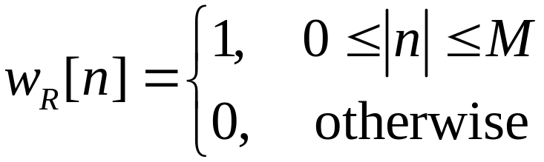
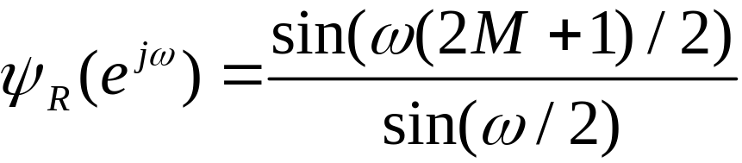
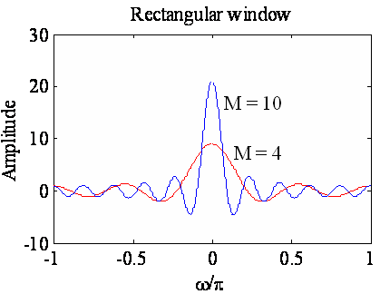
A rectangular window is used to achieve simple truncation:
main lobe
Width: 4π/(2M+1)
side-lobes
（掌握）

Slide 22



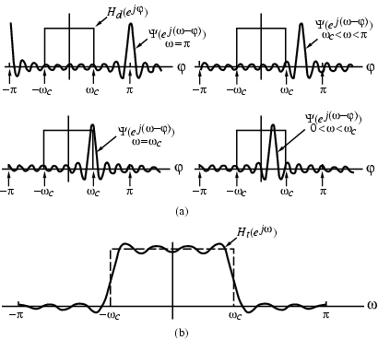
Thus is obtained by a periodic continuous
convolution of with
（掌握）

Slide 23
As can be seen, as the length of the lowpass filter is increased, the number of ripples in both passband and stopband increases, with a corresponding decrease in the ripple widths;
Height of the largest ripples remain the same independent of length;
→ Gibbs phenomenon
Area under each lobe remains constant while width of each lobe decreases with an increase in M.
Similar oscillatory behavior observed in the magnitude responses of the truncated versions of other types of ideal filters.
（掌握）

Slide 24
Increasing the truncation-length of window can decrease the width of the transition band, but can’t change the relative value of the main-lobe and side-lobes.
So, we need a window:
(1) It’s main lobe width is as narrow as possible to ensure
a fast transition from passband to stopband.
(2) Reducing the relative magnitude of the maximum
sidelobe to reduce the passband and stopband ripple.
（掌握）

Slide 25
Rectangular window has an abrupt transition to zero outside the range -M≤n≤M , which results in Gibbs phenomenon in
Gibbs phenomenon can be reduced either:
(1) Using a window that tapers smoothly to zero at
each end;
(2) Providing a smooth transition from passband to
stopband in the magnitude specifications.
（掌握）

Slide 26
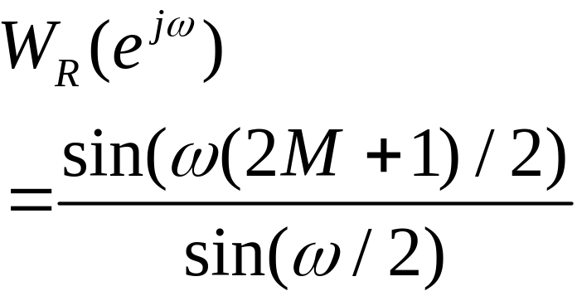
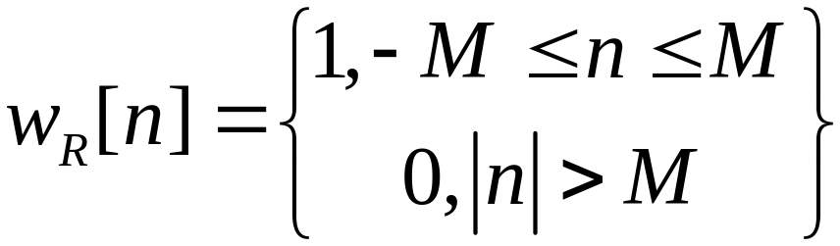
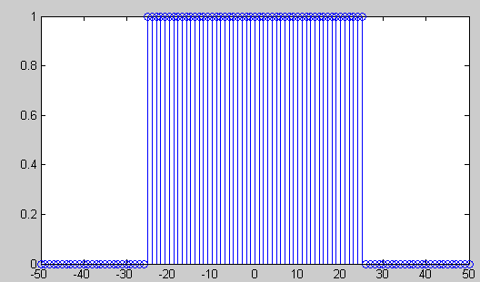
10.2.4 Fixed Window Functions
Rectangular window
Rectangular window
0
-20
-40
Gain, dB
-60
-80
-100
0
0.2
0.4
0.6
0.8
1
w
/
p
（掌握）

Slide 27
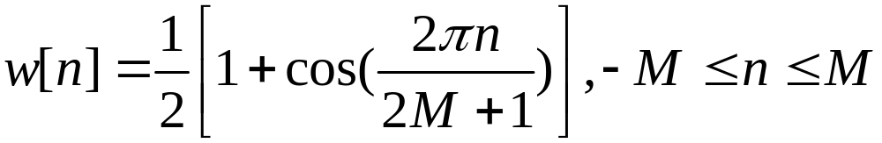
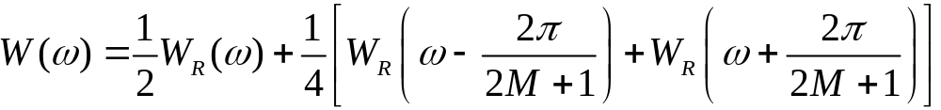
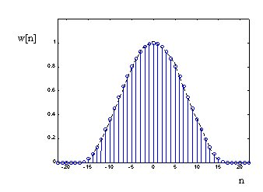
Hanning window
Hanning window
0
-20
-40
Gain, dB
-60
-80
-100
0
0.2
0.4
0.6
0.8
1
ω
/
π
（掌握）

Slide 28
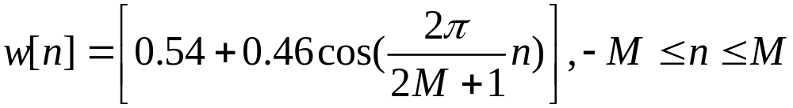
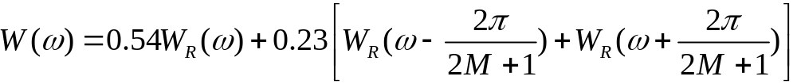
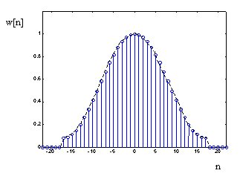
Hamming window:
Hamming window
0
-20
Gain, dB
-40
-60
-80
-100
0
0.2
0.4
0.6
0.8
1
ω
/
π
（掌握）

Slide 29



Blackman window:
Blackman window
0
-20
-40
Gain, dB
-60
-80
-100
0
0.2
0.4
0.6
0.8
1
ω
/
π
（掌握）

Slide 30
Performance of a window function in LPF design
Magnitude spectrum of each window characterized by a main lobe centered at ω = 0 followed by a series of sidelobes with decreasing amplitudes.
Parameters predicting the performance of a window in filter design are:
Main lobe width --- Δ_{ML}
Relative sidelobe level --- A_{sl}
  given by the difference in dB between amplitudes of largest sidelobe and main lobe.
（掌握）

Slide 31



Observe
  Thus,
Passband and stopband ripples are same.
（掌握）

Slide 32
Distance between the locations of the maximum passband deviation and minimum stopband value ≅ Δ_{ML}
Width of transition band:
Δω = ω_{s} - ω_{p} < Δ_{ML}
To ensure a fast transition from passband to stopband, window should have a very small main lobe width.
To reduce the passband and stopband ripple d, the area under the sidelobes should be very small.
Unfortunately, these two requirements are contradictory.
（掌握）

Slide 33


Rectangular and Blackman windows
（掌握）

Slide 34
In the case of rectangular, Hann, Hamming, and Blackman windows, the value of ripple does not depend on filter length or cutoff frequency ω_{c}, and is essentially constant.
In addition,
Δω ≈ c / M
where c is a constant for most practical purposes.
→So, we can determine Δω by M.
（掌握）

Slide 35
Table 10.2 Properties of some fixed window functions
Type of windows | Main lobe width Δ_{ML} | Relative sidelobe level A_{sl} | Minimum stopband attenuation α_{s} | Transition bandwidth Δ_{ω}
Rectangular | 4π/(2M+1) | 13.3dB | 20.9dB | 0.92π/M
Hann | 8π/(2M+1) | 31.5dB | 43.9dB | 3.11π/M
Hamming | 8π/(2M+1) | 42.7dB | 54.5dB | 3.32π/M
Blackman | 12π/(2M+1) | 58.1dB | 75.3dB | 5.56π/M
（掌握）

Slide 36
Plots of magnitudes of the DTFTs of these windows for M = 25 are shown below:
Rectangular window
Hanning window
0
0
-20
-20
Gain, dB
-40
Gain, dB
-40
-60
-60
-80
-80
-100
0
0.2
0.4
0.6
0.8
1
-100
0
0.2
0.4
0.6
0.8
1
ω
/
π
ω
/
π
Hamming window
Blackman window
0
0
-20
-20
Gain, dB
-40
Gain, dB
-40
-60
-60
-80
-80
-100
0
0.2
0.4
0.6
0.8
1
-100
0
0.2
0.4
0.6
0.8
1
ω
/
π
ω
/
π
（掌握）

Slide 37


10.2.5 Adjustable Window Functions
Kaiser window
Where:
We can adjust β to modify the window function. So, it is called as adjustable window function.
Equation(10.41) and (10.42) give how to get β and N.
（掌握）

Slide 38




Dolph-Chebyshev window
Where, γ is the relative sidelobe amplitude.
（掌握）

Slide 39

Example of FIR Filter Design:
Design a linear phase FIR LPF:
If given the passband edge frequency ω_{p}=0.3π, the passband ripple is 1dB，the stopband edge frequency ω_{s}=0.5π, the minimum stopband attenuation <-40dB.
Solution:
α_{p} =1dB, α_{s}=40dB
（掌握）

Slide 40



The ideal LP impulse response is:
Select a window based on table 10.2 and specifications: α_{s}=40dB;
If we select window Hann, calculate order N:
（掌握）

Slide 41



If we select window Hamming:
If we select window Blackman:
If we select window Kaiser:
（掌握）

Slide 42
FIR Filter Design Example 1
The specifications of a low pass filter:
Pass band edge 400Hz
Stop band edge 1650Hz
Stop band attenuation 50dB
Sampling frequency 11.025kHz
（掌握）

Slide 43


Transition width △f = 1650-400 = 1250Hz
Another parameter fc = (400+1650)/2 = 1025 Hz, So
Choose Hamming window (-54dB),
（掌握）

Slide 44


The finite-length causal FIR LP filter:
∴ N=2M+1=31
（掌握）

Slide 45


The Hamming window is
So, h[n] of the filter which we need is
Then the magnitude response and the impulse response are drawn in next silde:
（掌握）

Slide 46



So, the original sound:
the output sound after passing the LP filter:
（掌握）

Slide 47
FIR Filter Design Example 2
The specifications of a high pass filter:
Pass band edge 1650Hz
Stop band edge 400Hz
Stop band attenuation 50dB
Sampling frequency 11.025kHz
（掌握）

Slide 48
Transition width △f = 1650-400 = 1250Hz
Another parameter fc = (400+1650)/2 = 1025 Hz,
Choose Hamming window (-54dB),
（掌握）

Slide 49

The finite-length causal FIR HP filter:
∴ N=2M+1=31
（掌握）

Slide 50
The Hamming window is ( no change )
So, h[n] of the filter which we need is
Then the magnitude response and the impulse response are drawn in next silde:
（掌握）

Slide 51


（掌握）

Slide 52


Supplement: FIR Filter Design Based on Frequency Sampling Approach
Find an approximation of the desired FR H(e^{jω}) in frequency domain.
The method:
Let denote the sampling values of
N+1-point FIR filter
（理解）

Slide 53




Use to approximate the desired frequency response , then from: we can get the length-N impulse response h[n] of the FIR filter.
Note:H[k] must satisfy the constraint that the FIR filter is linear phase.
（理解）

Slide 54

For example, a LPF with one sample of magnitude on the transition band is shown bellow.
（理解）

Slide 55
10.5 FIR Digital Filter Design Using MATLAB
The Signal Processing Toolbox of MATLAB includes a variety of M-files for the design of FIR digital filters
We will illustrate the use of some these functions in the following.
Also, we can use the GUI design tools in MATLAB FDATool command !
（自学）

Slide 56
The window-based FIR filter design process involves
three steps:
The type of windows to be used is determined to meet the desired stop-band attenuation or pass-band ripple.
The order of the FIR is estimated by using Table10.2 or Eq.(10.45) for Kaiser window.
The desired impulse response of the ideal filter is computed, which is then multiplied by the window coefficients.
（自学）

Slide 57
The M-file kaiord determines the FIR filter order using Kaiser’s formula.
The M-file bellangord determines the FIR filter order using Bellanger’s formula.
The M-file remezord determines the FIR filter order using Hermann’s formula.
Using the Kaiser window, the order can be estimated using the formula of (10.45). The M-file kaiserord can be employed.
（自学）

Slide 58
The functions available in MATLAB for the design of FIR filters using the win-dows Fourier approach are fir1 and fir2.
The function fir1 is used to design conventional lowpass, highpass, bandpass, bandstop and multiband FIR.
The function fir2 is employed to design FIR with arbitrarily shaped magnitude response.
（自学）

Slide 59
Window Generation
W=hann(L)
W=hamming(L)
W=blackman(L)
W=kaiser(L,beta)
Filter Design
b=fir1(N,Wn) %N-order, Wn=[w1,w2,…]
b=fir1(N,Wn,’ftype’) %ftype—lpf,hpf,..
b=fir1(N,Wn,window) %default hamming
（自学）

Slide 60
Example 10.25
% Lowpass Filter Design Using the Kaiser Window
fpts = input('Type in the bandedges = ');
mag = input('Type in the desired magnitude values = ');
dev = input('Type in the ripples in each band = ');
[N, Wn, beta, ftype] = kaiserord(fpts,mag,dev)
kw = kaiser(N+1,beta);
b = fir1(N,Wn, kw);
[h,omega] = freqz(b,1,512);
plot(omega/pi,20*log10(abs(h)));grid;
xlabel('\omega/\pi'); ylabel('Gain, dB');
（自学）

Slide 61

Type in the bandedges = [0.3 0.4]
Type in the desired magnitude values = [1 0]
Type in the ripples in each band = [0.003162 0.003162]
N = 59
Wn = 0.3500
beta = 4.5513
ftype = low
（自学）

Slide 62

Example 10.26
Use the same program as Example 10.25
by modifying
b = fir1(N,Wn,'high',kw);
Type in the bandedges = [0.4 0.55]
Type in the desired magnitude values = [0 1]
Type in the ripples in each band = [0.02 0.02]
N = 26
Wn = 0.4750
beta = 2.6523
ftype = high
（自学）

Slide 63

FIR Digital Filter Design Using MATLAB
（自学）

Slide 64

FIR Digital Filter Design Using MATLAB
Design a linear phase FIR LPF:
If given the passband edge frequency f_{p}=300Hz, the passband ripple is 1dB，the stopband edge frequency f _{s}=450Hz, the minimum stopband attenuation<-25dB. The sampling rate is 3000Hz.
（自学）

Slide 65
Homework:
10.1, 10.17, 10.30, 10.31
M10.8, M10.9, M10.17

